Slide 1

ITU AI/ML Challenge:
Wireless foundation model (WiFo) empowered SoM system design
——Webinar for Synesthesia of Machines (SoM) Challenge 2025
Speaker: Boxun Liu* & Xuesong Cai
Organizer: Pervasive Connectivity and Networked Intelligence (PCNI) Group, School of Electronics, Peking University
Platform: ITU AI for Good
Sponsorship: Huawei Technologies Co., Ltd.
Email: boxunliu@stu.pku.edu.cn
November 26, 2025

Slide 2
Outline
Background: SoM and WiFo
Problem Statement and Evaluation Criteria
Datasets and Baselines
Competition Procedure

Slide 3
Outline
Background: SoM and WiFo
Problem Statement and Evaluation Criteria
Datasets and Baselines
Competition Procedure

Slide 4
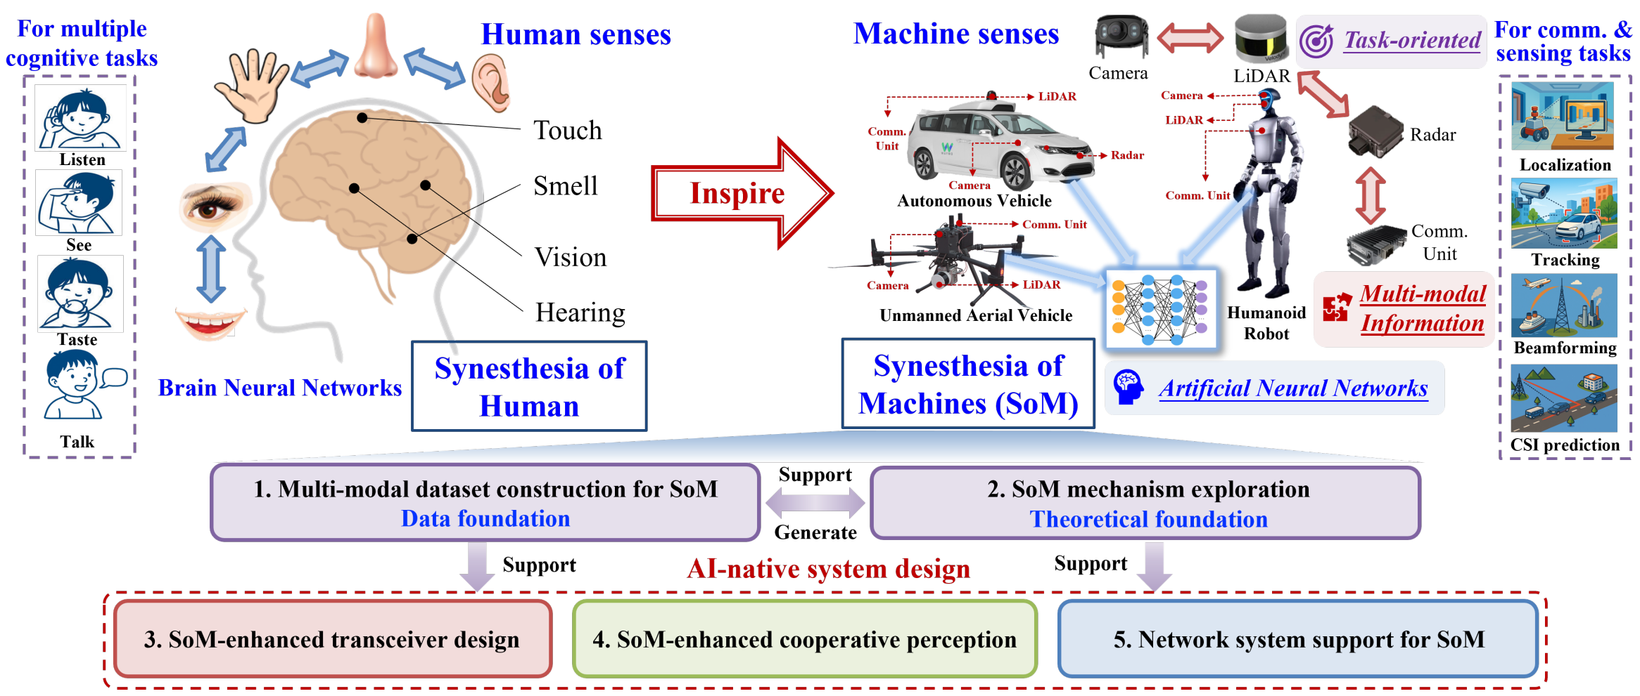
SoM
Synesthesia of Machines (SoM) ^{[1]}: a novel paradigm for AI-native intelligent multi-modal sensing communication integration
  SoM-enhanced transceiver design: AI-native multi-modal sensing aided wireless physical layer (PHY)
[1] X. Cheng et al., “Intelligent multi-modal sensing-communication integration: Synesthesia of Machines,” IEEE Commun. Surveys Tutor., Jan. 2024.

Slide 5
SoM-enhanced transceiver design
Existing works have applied task-specific AI models for various PHY modules: modulation / demodulation, precoding, CSI feedback, and channel estimation/prediction
Source
Channel Encoding
Signal Modulation
Precoding
Over-the-air Transmission
Wireless Channel
Sink
Channel Decoding
Signal Demodulation
Channel Equalization
Channel Reconstruction
MLP/CNN/RNN [Lyu`18-ICC]
TinyTurbo [Hebbar` 22-ISIT]
NeuralBCJR [Kim` 20-J-SAIT]
EPNet [Zhang20 ` -TWC]
GEPNet [Kosasih`22-JSAC]
DeepSIC [Nir`20-TWC]
WMMSENet [Pellaco`21-ICASSP]
MMFF [Zhang`24-TWC]
Bi-RNN [Deligiannidis`21-JLT]
COMPaCT [Ju`24-TWC]
VAE [Baur`24-GC TSP]
FIRE[Liu`21-MobiCom]
Poor Performance: Struggling with highly dynamic environments and complex PHY tasks
Limited Generalization: Retraining needed for channel distribution shifts, hindering deployment
Disjoint Design: Sharply increasing the storage, computation, and management cost at the BS

Slide 6
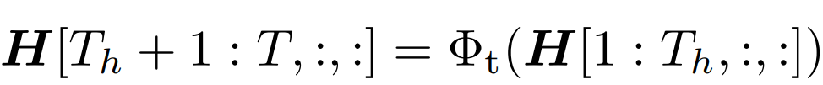

Wireless Foundation Models
Wireless foundation models: a new paradigm for wireless PHY design
  A model pre-trained on broad wireless data typically at scale using self-supervision, and adaptable to a wide range of wireless tasks through few-shot or even zero-shot learning, outperforming task-specific models.
WiFo^{[1]}: The first wireless foundation model for channel prediction
  The first model to address time-domain and frequency-domain prediction tasks in a one-for-all manner, handling diverse CSI distributions and system configurations
  Pretrained on a massive heterogeneous CSI dataset, WiFo can be directly utilized for channel prediction without fine-tuning
Time-domain
Frequency-domain
Existing models: separate design
WiFo: a unified model
[1] B. Liu, S. Gao, X. Liu, X. Cheng, L. Yang. “WiFo: Wireless Foundation Model for Channel Prediction. ” SCIENCE CHINA Information Sciences, June 2025, 68(6): 162302

Slide 7
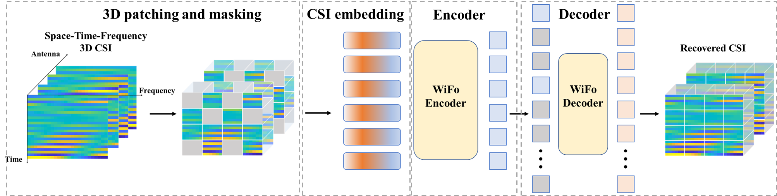
WiFo: Network Structure
Masked autoencoder (MAE) based network structure for CSI reconstruction
  3D patching and masking: process the original 3D CSI with 3D patching and masking
  CSI embedding: embed visible CSI patches into a series of tokens and feed them into the encoder
  Encoder: Vision Transformer (ViT) as the backbone network with proposed STF positional encoding
  Decoder: concatenate CSI tokens with learnable mask tokens, and adopt a lightweight ViT architecture as backbone network. Finally, original CSI is reconstructed using MLP
[1] B. Liu, S. Gao, X. Liu, X. Cheng, L. Yang. “WiFo: Wireless Foundation Model for Channel Prediction. ” SCIENCE CHINA Information Sciences, June 2025, 68(6): 162302

Slide 8
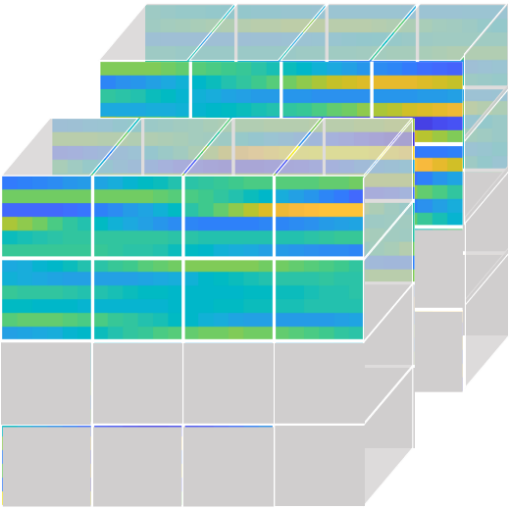
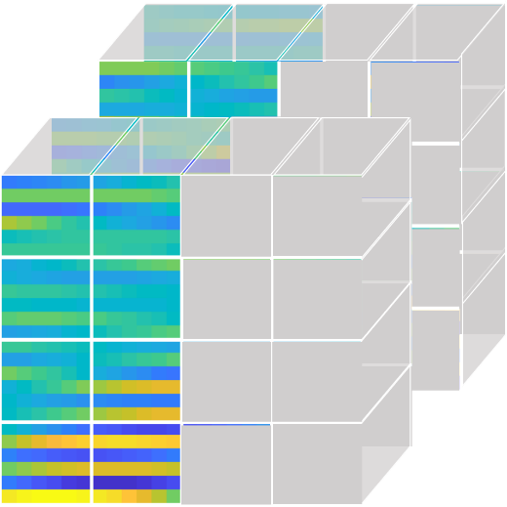
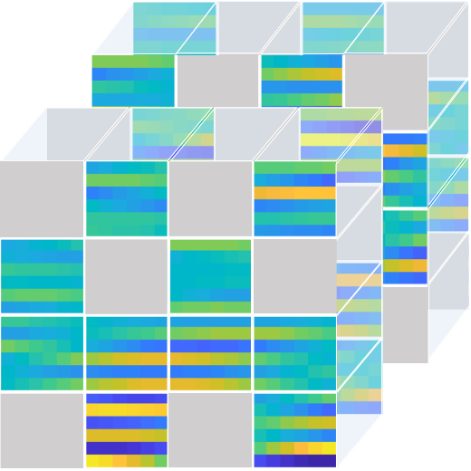
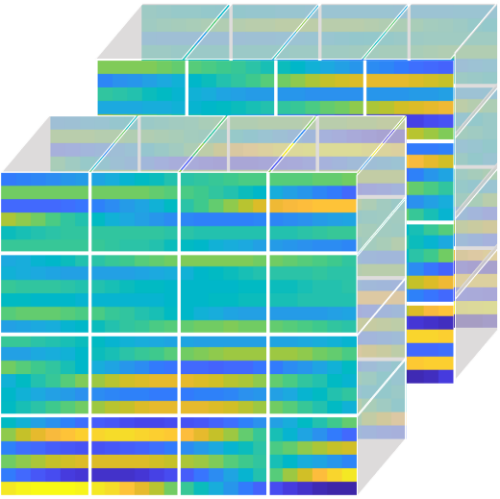
Self-Supervised Pre-training
Pre-training scheme: masked reconstruction
  Time-domain/frequency-domain/random masked reconstruction: mask CSI along time dimension, frequency dimension, or randomly to enhance the multi-domain channel prediction capability
  Loss function: minimizing the NMSE between reconstructed CSI and original CSI
WiFo
Time-masked
reconstruction
Frequency-masked
reconstruction
Random-masked
reconstruction
Original CSI
Model inference: After pre-training, WiFo possesses a general CSI reconstruction capability, which can be directly applied to time-domain/frequency-domain channel prediction

Slide 9
WiFo
Experimental results
  WiFo is capable of training on 16 heterogeneous CSI datasets
  WiFo demonstrates remarkable zero-shot channel prediction performance, even surpassing the full-shot performance of task-specific AI baselines.
Its masked self-supervised training approach enables powerful CSI representation learning, making it highly promising for a broad spectrum of CSI-related downstream SoM tasks.
Competition objective
  Fully explore WiFo’s potential to empower CSI-related downstream tasks through fine-tuning
  Three representative CSI-related SoM tasks: channel estimation, LoS/NLoS classification, and Vision-aided wireless localization
  The base version of WiFo is adopted：21.6M parameters

Slide 10
Outline
Background: SoM and WiFo
Problem Statement and Evaluation Criteria
Datasets and Baselines
Competition Procedure

Slide 11
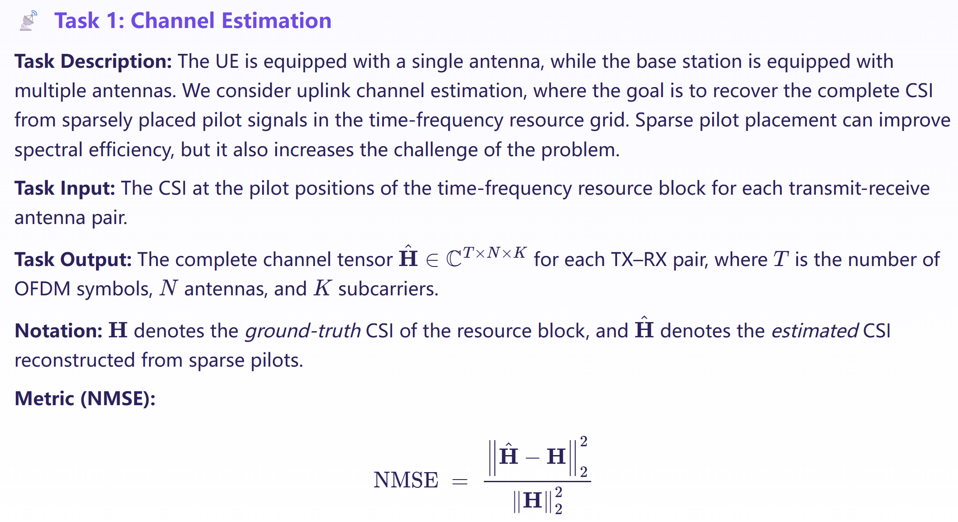
Problem Statement

Slide 12
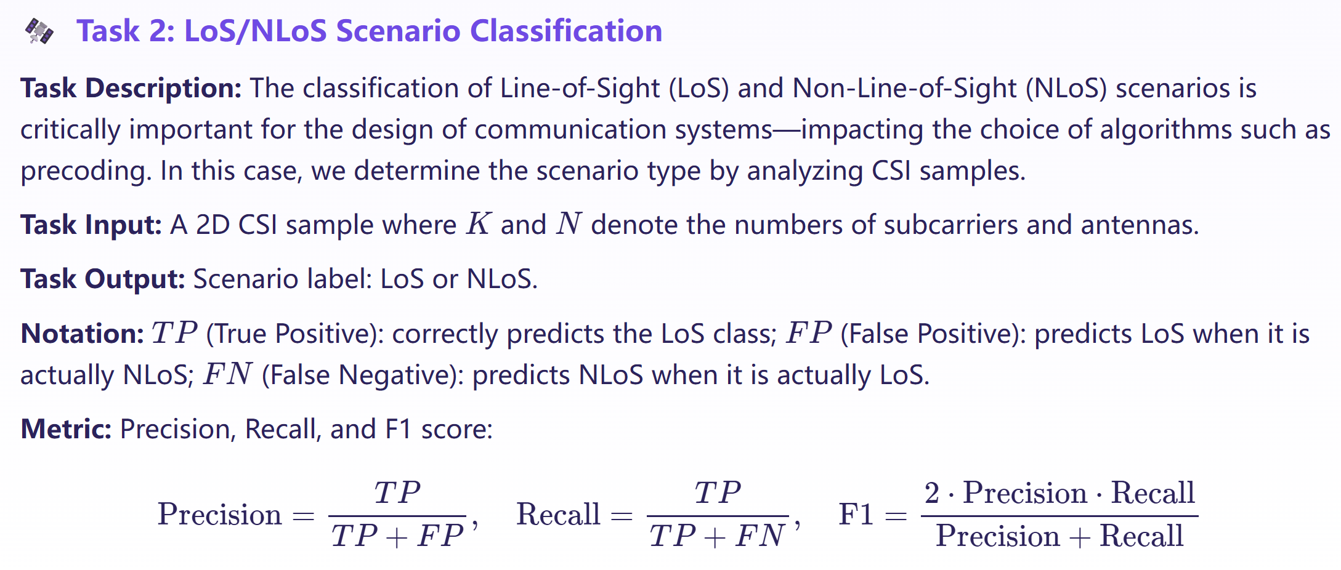
Problem Statement

Slide 13
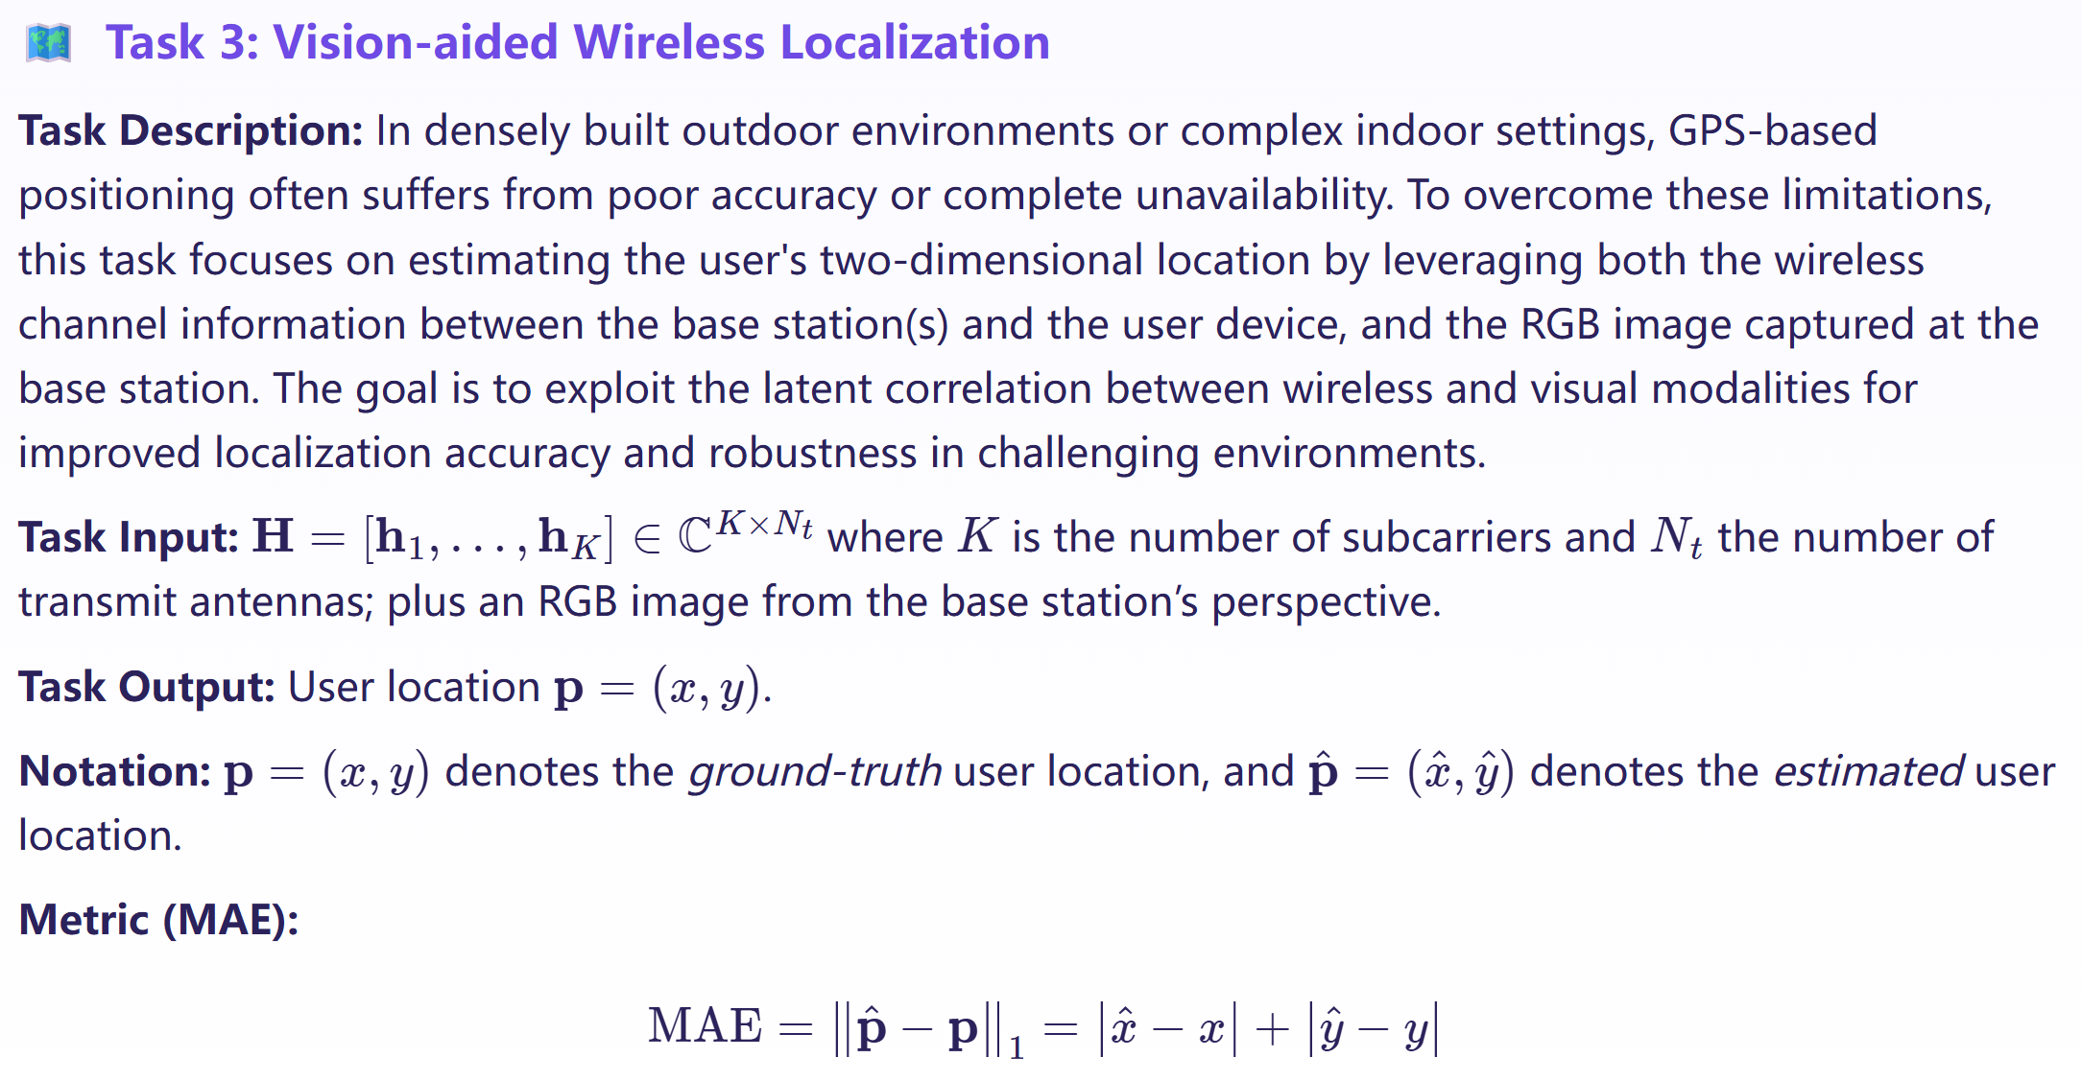
Problem Statement

Slide 14
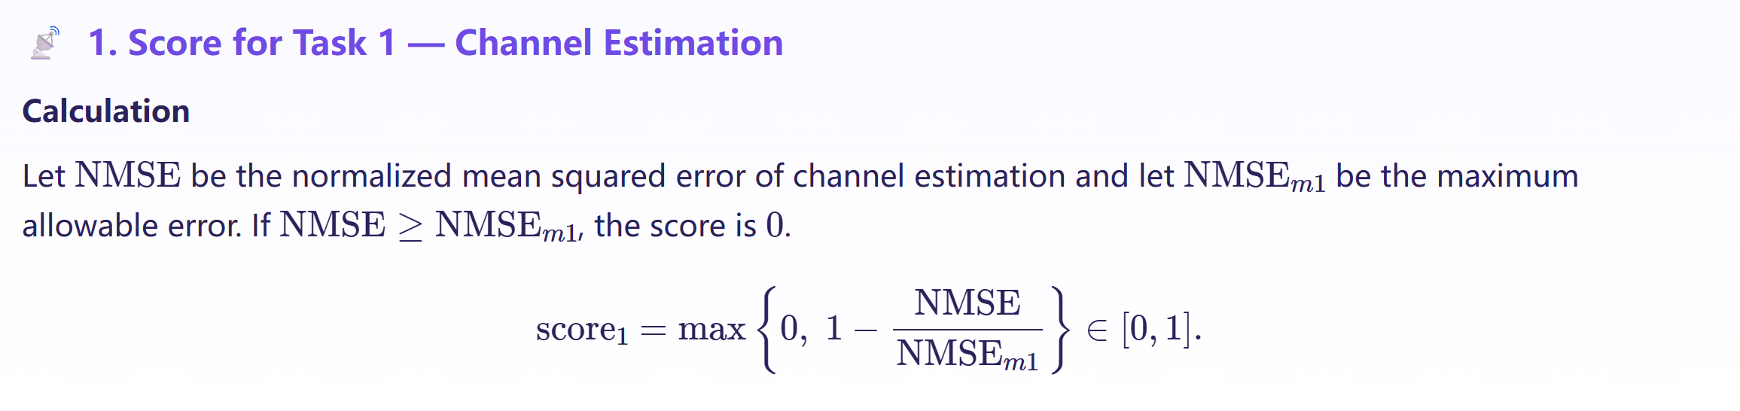
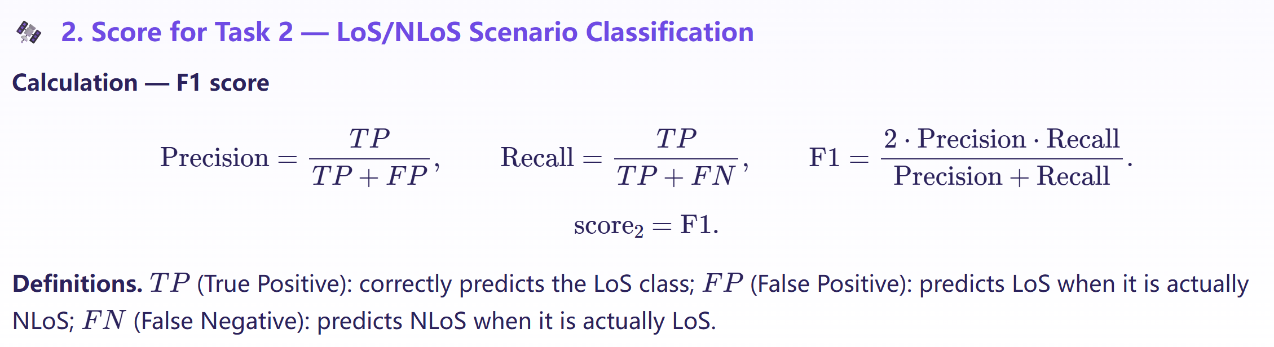
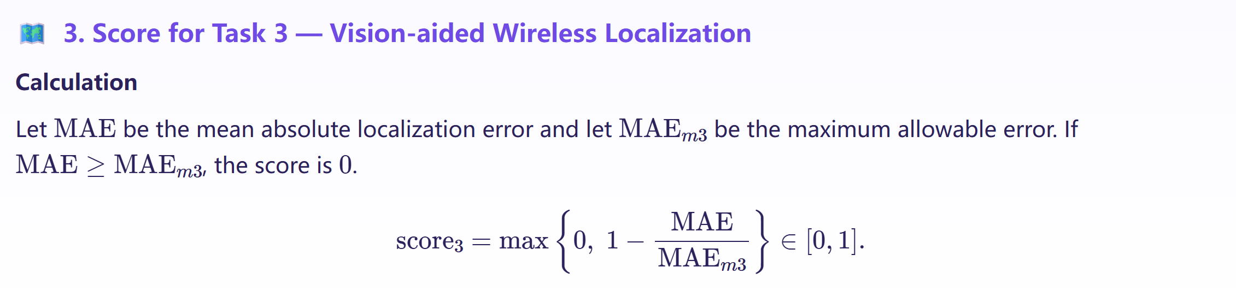


Evaluation
$${NMSE}_{m1}=1$$
Task-specific score
$${MAE}_{m3}=10$$

Slide 15
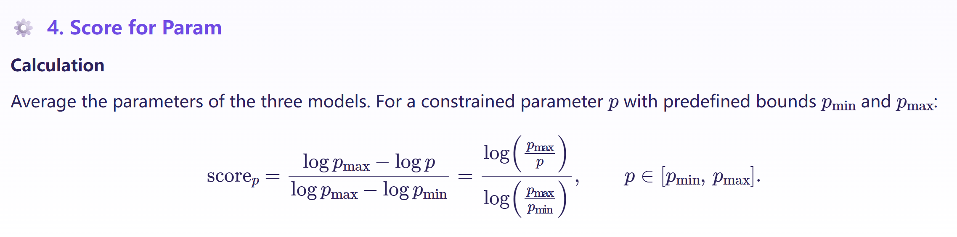
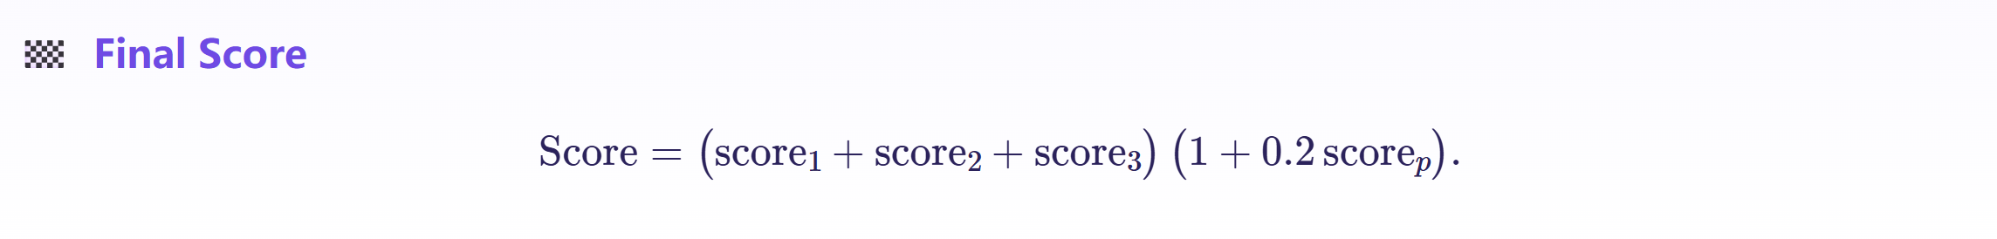

Evaluation
Model practicality score
$p_{max}=10M$, and $p_{min}=0.001M$
Final score
Note: Param refers to the number of fine-tuned parameters, not the total number of model parameters.

Slide 16
Outline
Background: SoM and WiFo
Problem Statement and Evaluation Criteria
Datasets and Baselines
Competition Procedure

Slide 17
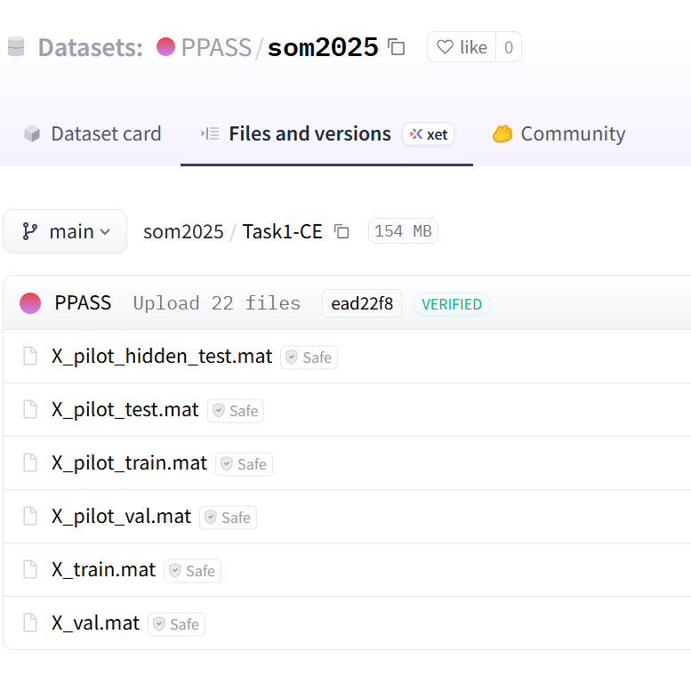
Dataset source
Pre-training dataset
  WiFo-Base is pretrained on 16 unlabeled wireless channel datasets that cover a wide range of scenarios, including diverse antenna configurations, carrier frequencies, and user mobility patterns.
  (Optional) Participants may further pretrain WiFo-Base on additional unlabeled datasets to enhance generalization and overall performance.
**Downstream fine-tuning dataset: https://huggingface.co/datasets/PPASS/som2025/tree/main
  Dedicated datasets will be provided for each downstream task to fine-tune WiFo-Base. The dataset for each task includes a training set, a validation set, a public testing set, and a hidden challenge testing set (the latter two without labels)
    Training set and validation set is used for fine-tuning
    Public testing set is for evaluation during development phase: online evaluation by the system for submitted results
    Hidden challenge testing set is reserved for test phase: manual evaluation by the organizers for the submitted code

Slide 18
Other sources
Model weights and code resources for this challenge
  ***Pre-trained weights of WiFo-Base: https://huggingface.co/liuboxun/WiFo/tree/main
  ***Baseline codes [includes training scripts for the three tasks, instructions to reproduce the scores, and the expected submission format.]: https://github.com/xuanyv/SoM2025-baseline
Other resources for reference
  Inference codes for WiFo: https://github.com/liuboxun/WiFo
  Other fine-tuning codes: https://github.com/liuboxun/LLM4CP ; https://github.com/xuanyv/LLM4WM
Strict rule on downstream training
  It is strictly prohibited to fine-tune WiFo-Base on any external datasets for downstream tasks. Violations will result in immediate disqualification

Slide 19
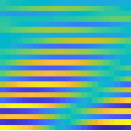
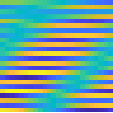
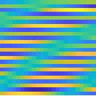
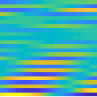
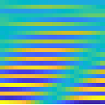
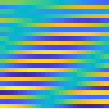
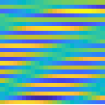
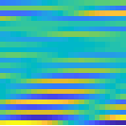
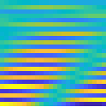
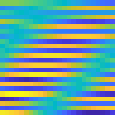
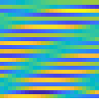
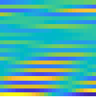
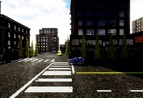
Baselines
Introduction to the WiFo fine-tuning code (first open-source release)
  Task1：First interpolate to obtain raw CSI, then use the WiFo encoder–decoder to reconstruct the estimated CSI.
  Task2：Use WiFo-encoder to extract channel representations, and then apply a linear classifier to obtain the prediction.
  Task3：Extract channel features with the WiFo-encoder, combine them with RGB features, and predict the user’s position.
To achieve a higher score, you can:
  Optimize the fine-tuning strategy
  Optimize the data preprocessing pipeline
  Tune the network hyperparameters
  Or be lucky enough 😉
Interpolation
WiFo Encoder
WiFo Decoder
Coarse-grained CSI
Noisy CSI
Estimated CSI
…
Task1： Channel Estimation
WiFo Encoder
CSI
…
(x, y)
(user location)
0/1
(Los / NLoS)
Fusion Encoder
WiFo Encoder
Classification Head
Regression Head
CSI
RGB Encoder
…
RGB Image
…
Task2： Scenario Classification
Task3： Vision-aided Wireless Localization

Slide 20
Outline
Background: SoM and WiFo
Problem Statement and Evaluation Criteria
Datasets and Baselines
Competition Procedure

Slide 21
Competition Procedure
Phase I: Development Phase [Sep. 30, 2025~Feb. 1, 2026]
  Submission: Submit inference results on the public testing set to receive feedback on the public leaderboard.
  Leaderboard: Visible to all and intended for performance tracking, not final ranking.
  Only the top-5 teams will advance to the next phase
Phase II: Test Phase [Feb. 1, 2026~Feb. 10, 2026]
  Deliverables: Top-5 teams will provide materials for verification and reproducibility
    Runable inference code and model weights
    Documentation and Instructions
Final Evaluation Phase [Feb. 10, 2026~Feb. 15, 2026]
  The organizers will manually compute the scores based on the materials submitted by participants in the test phase and verify their compliance

Slide 22
Others
***Challenge forum: Q & A
  Link: https://github.com/liuboxun/WiFo/discussions/8
  We encourage all participants to ask questions on the forum to avoid duplicate inquiries.
Prizes: 4,000 CHF
  🥇 1st Prize: 2,290 CHF (≈ ¥20,000 RMB)
  🥈 2nd Prize: 1,140 CHF (≈ ¥10,000 RMB)
  🥉 3rd Prize: 570 CHF (≈ ¥5,000 RMB)
Deadlines
  Registration deadline: 15 December 2025
  Development phase deadline (determine the top-5 teams): 1 February 2026
  Final materials submission: 10 February 2026
  Final ranking announcement:15 February 2026
Contact via email
  Boxun Liu: boxunliu@stu.pku.edu.cn
  Xuanyu Liu: xyliu25@stu.pku.edu.cn

Slide 23

Thanks for your time!
Organizers:
Xiang Cheng
Xuesong Cai
Boxun Liu
Xunayu Liu

