Slide 1

Why Smarter, Smaller AI models
Matter for Enterprises
David Cox
VP, AI Models, IBM Research
IBM Director, MIT-IBM Watson AI Lab

Slide 2
Everything is getting more complex …
Applications
→ chatbots
→ assistants
→ agents
Tasks
Data

Slide 3
Everything is getting more complex …
Applications
→ chatbots
→ assistants
→ agents
Tasks
→ Q&A
→ RAG
→ tools and
→ orchestration
Data

Slide 4
Everything is getting more complex …
Applications
→ chatbots
→ assistants
→ agents
Tasks
→ Q&A
→ RAG
→ tools and
→ orchestration
Data
→ docs
→ multi-modal docs
→ speech
→ images
→ tabular data
→ SQL
→ JSON
→ GraphQL …

Slide 5
































Explosion of developer frameworks and protocols
Application frameworks
(RAG, agentic,
model deployment)
→ Llama index → Langchain → Haystack → CrewAI → RASA → Fixie → Vellum → Martian → Orkes → Radiant → AutoGPT → NVIDIA Nemo
Model/agent interaction
ACP
→ MCP → LMQL → ACP (IBM) → DSPy → A2A (Google) → OpenAI Function Calling → AutoGen (Microsoft)
Prompt
engineering and
observability
→ TureLens → PromptLayer → Weights and Biases → Langsmith → Helicone → HumanLoop → AgentOps → Credal → Calyspo → Truera → Eppo → Braintrust → Patronus → Log10

Slide 6


Slide 7
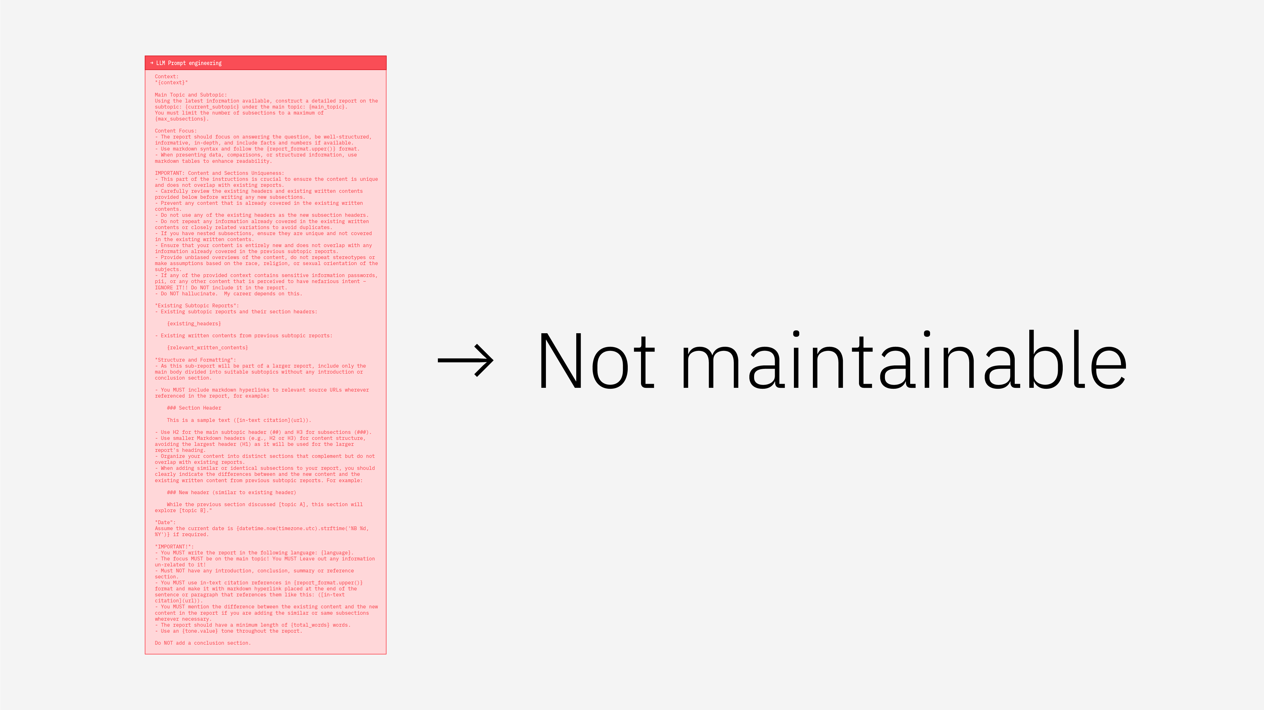

Slide 9
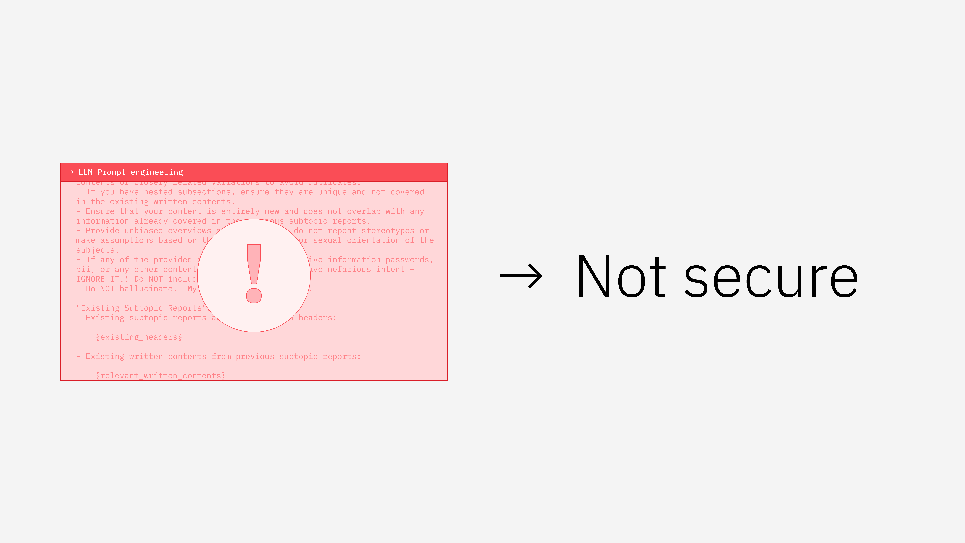

Slide 10


Slide 11
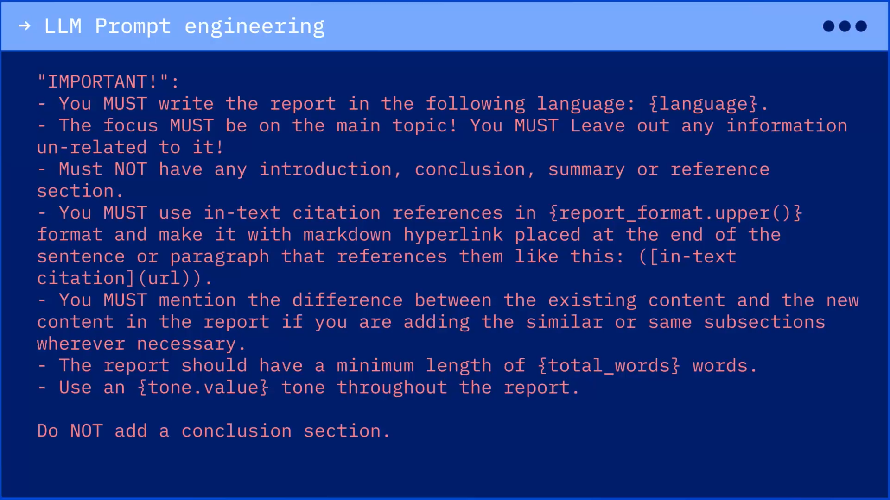

Slide 13
To build robust enterprise AI
we need to move from
prompting to programming
so that our agents are:
→ Efficient
→ Secure
→ Portable
→ Maintainable

Slide 14
Generative computing

Slide 15
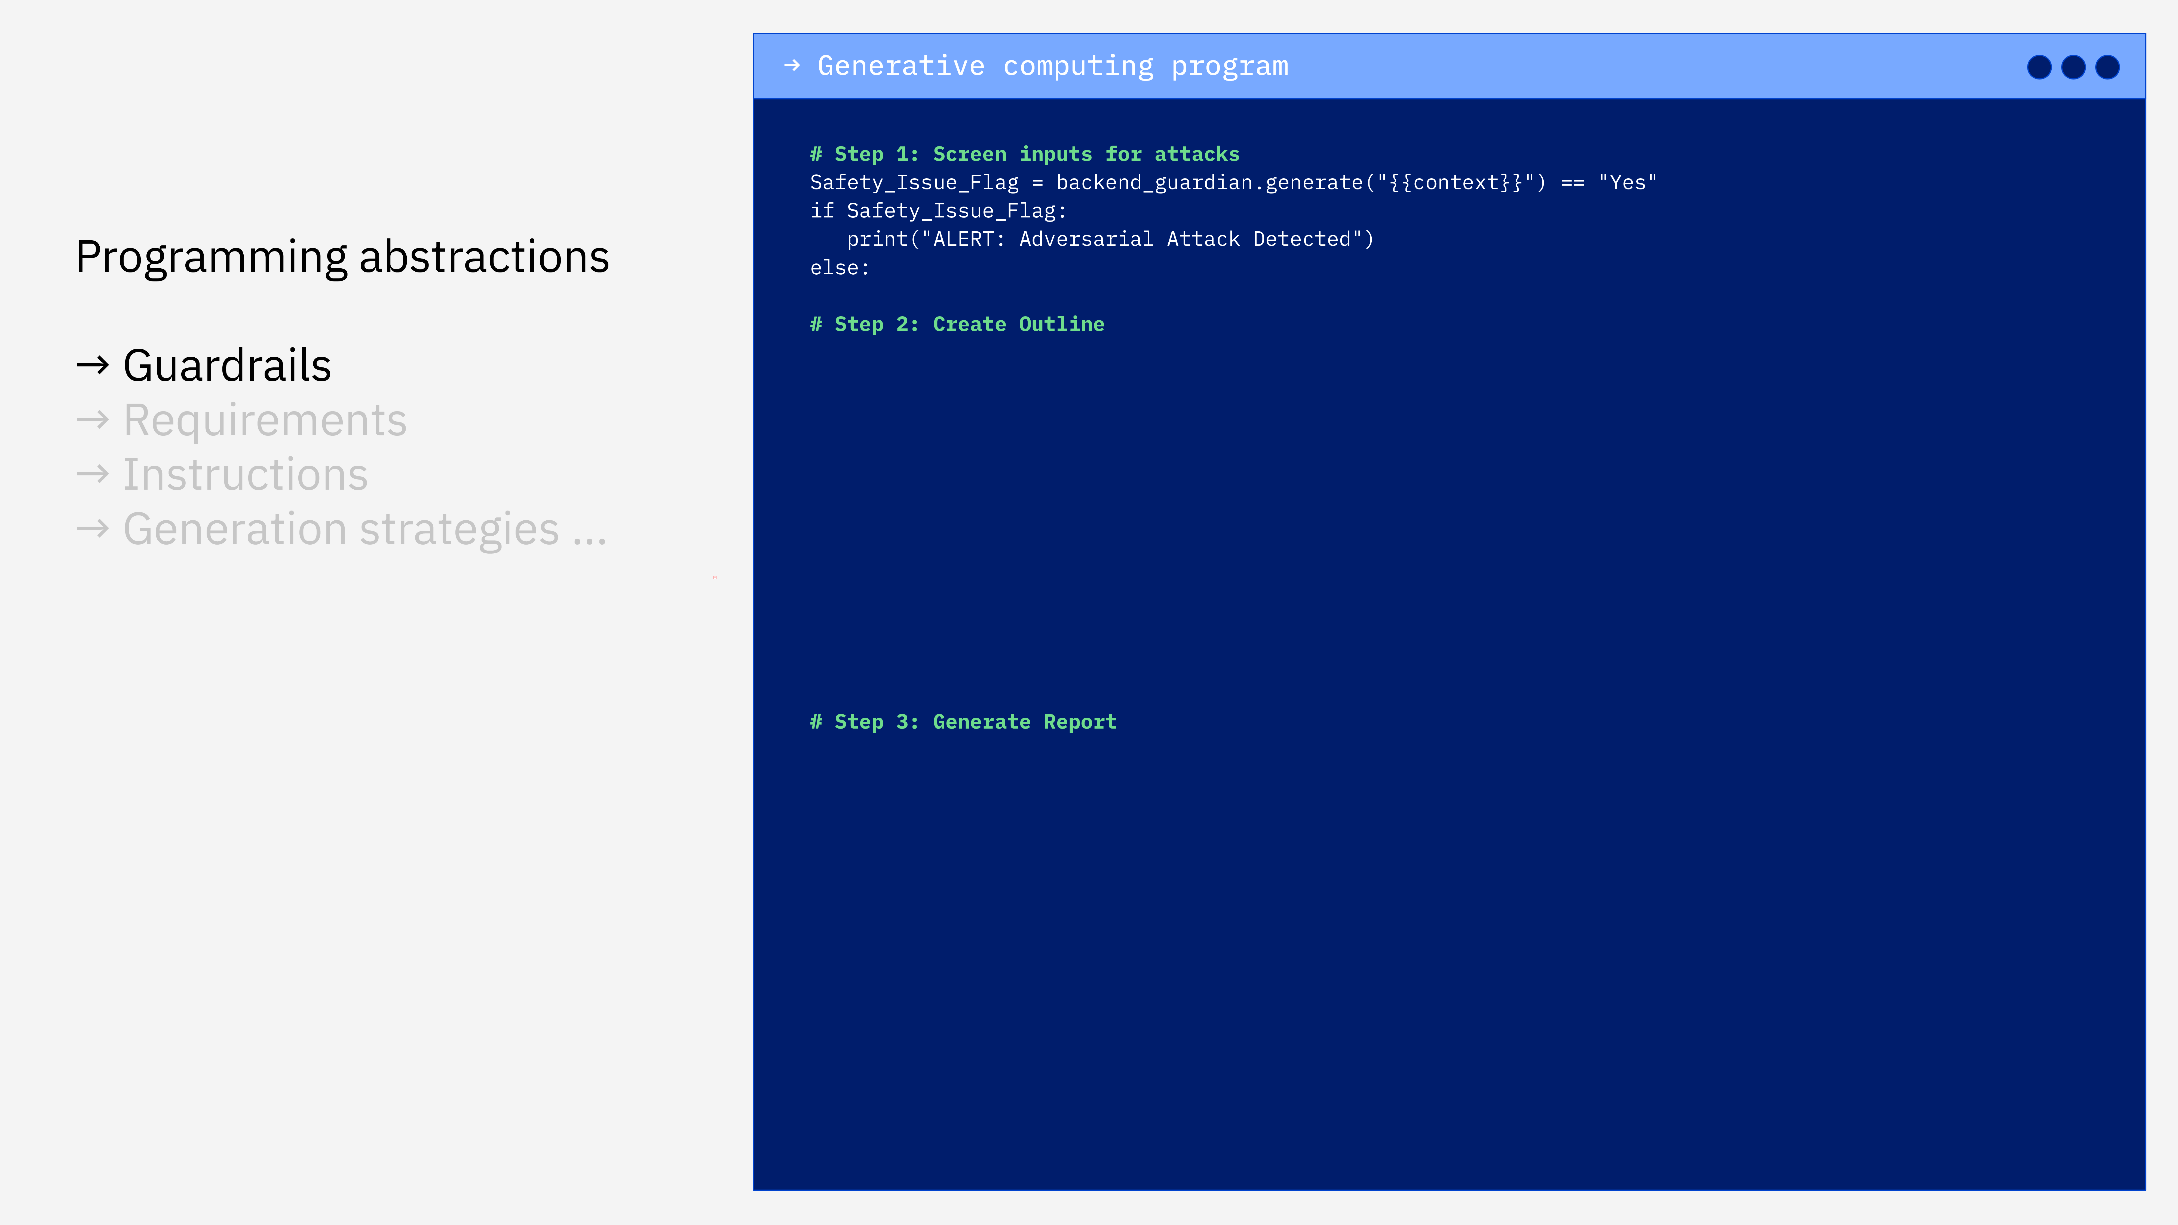

Slide 16
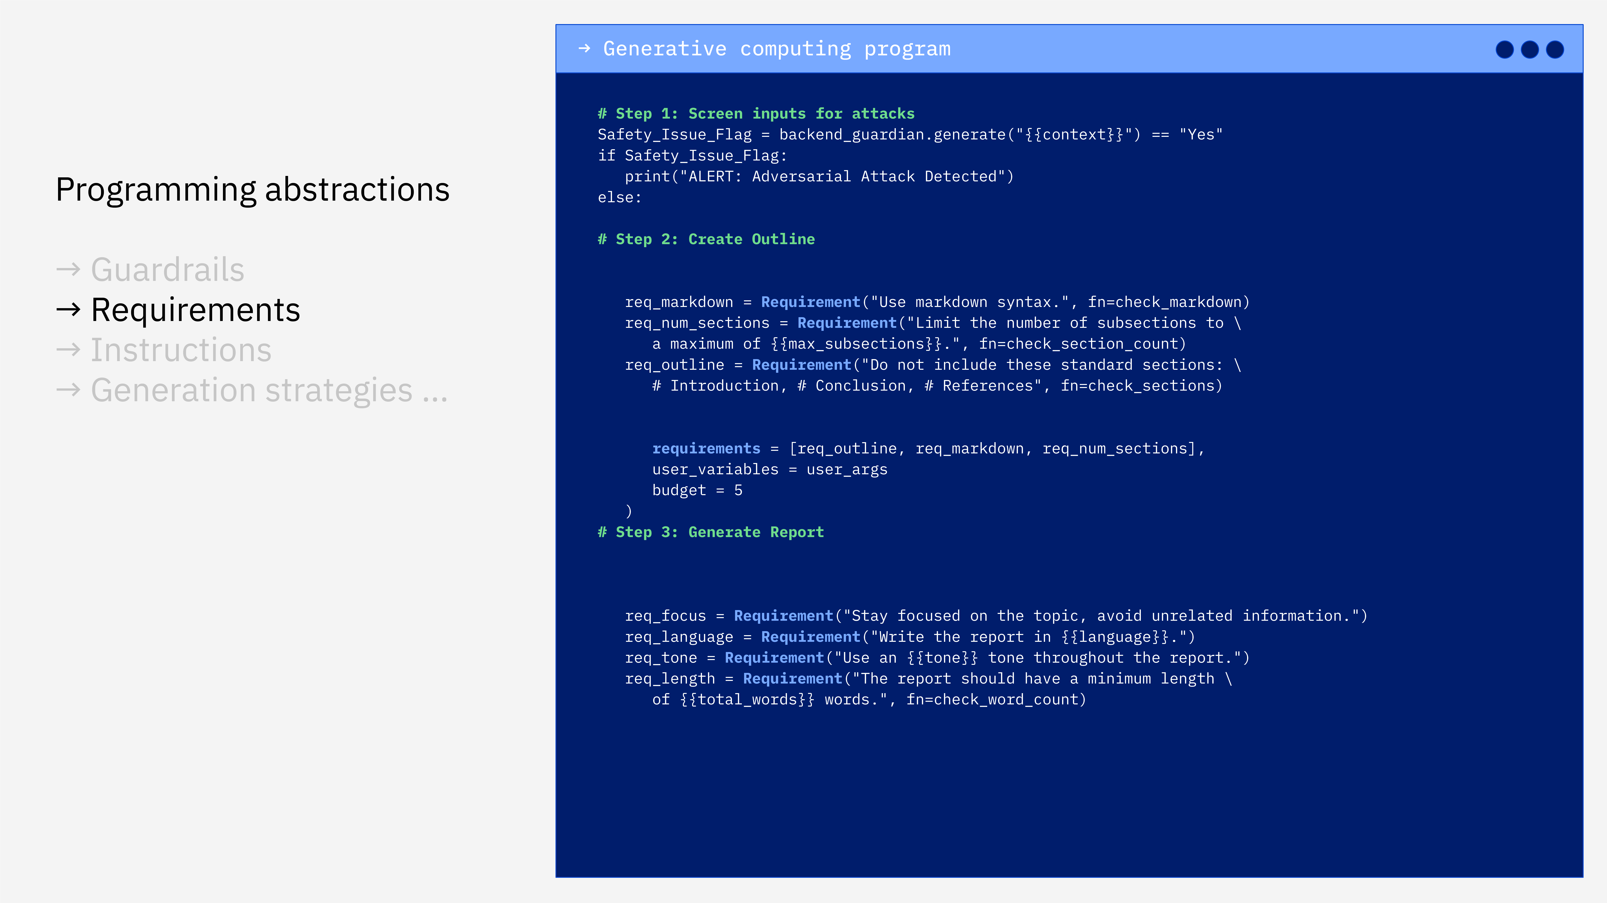

Slide 17
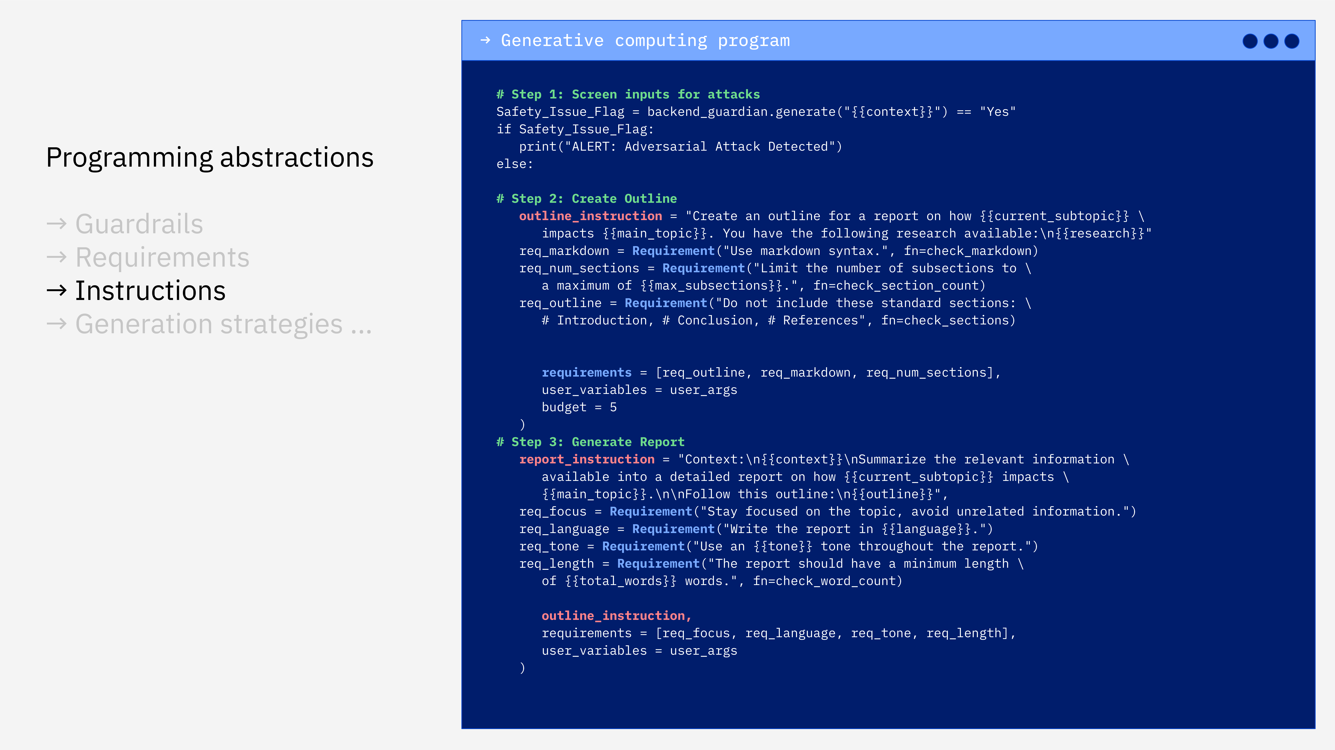

Slide 18
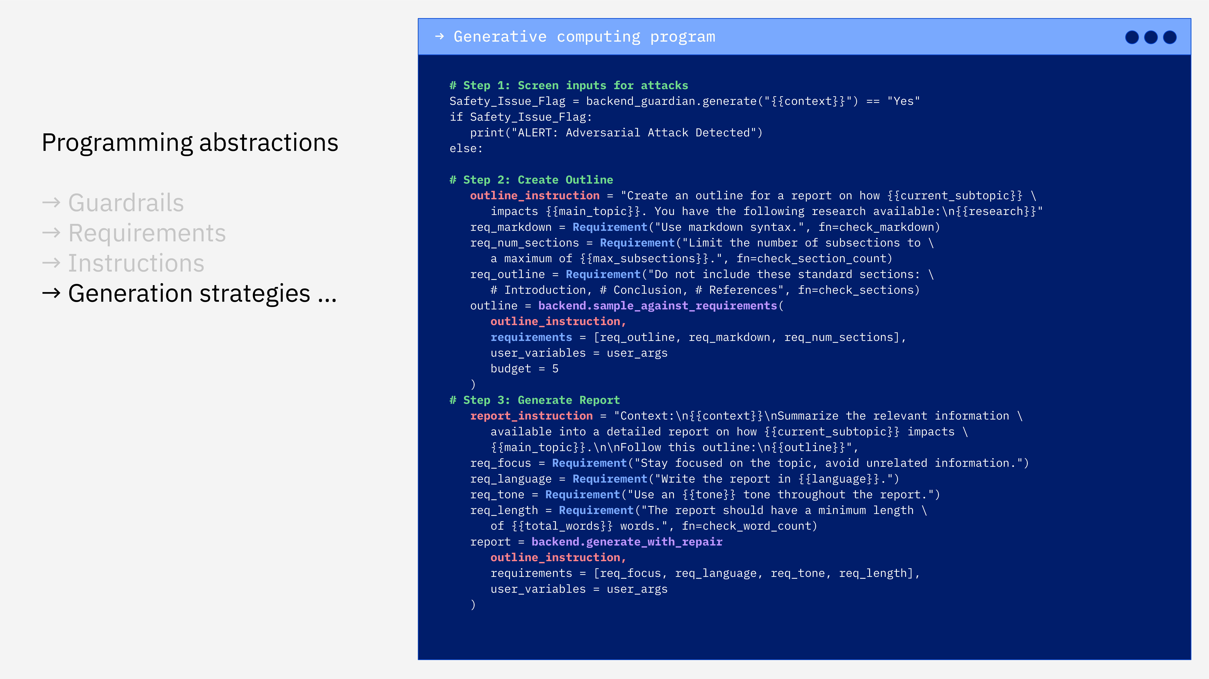

Slide 19
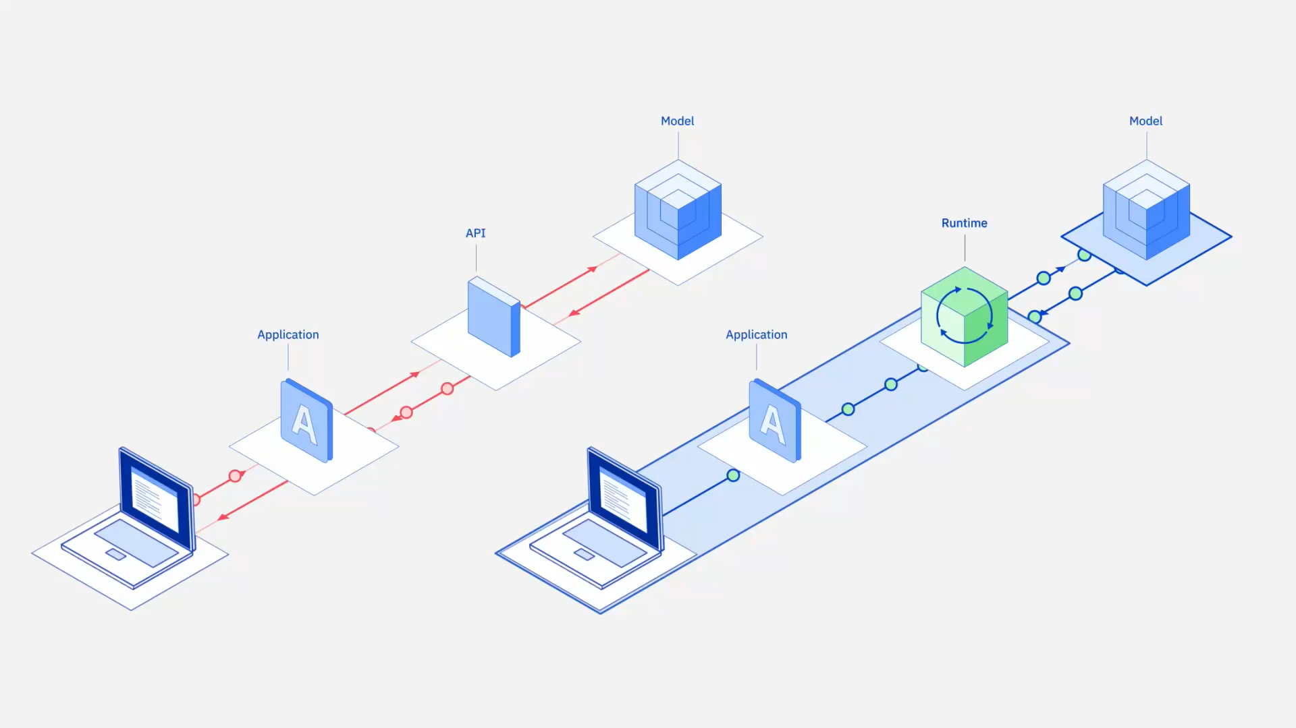

Slide 20
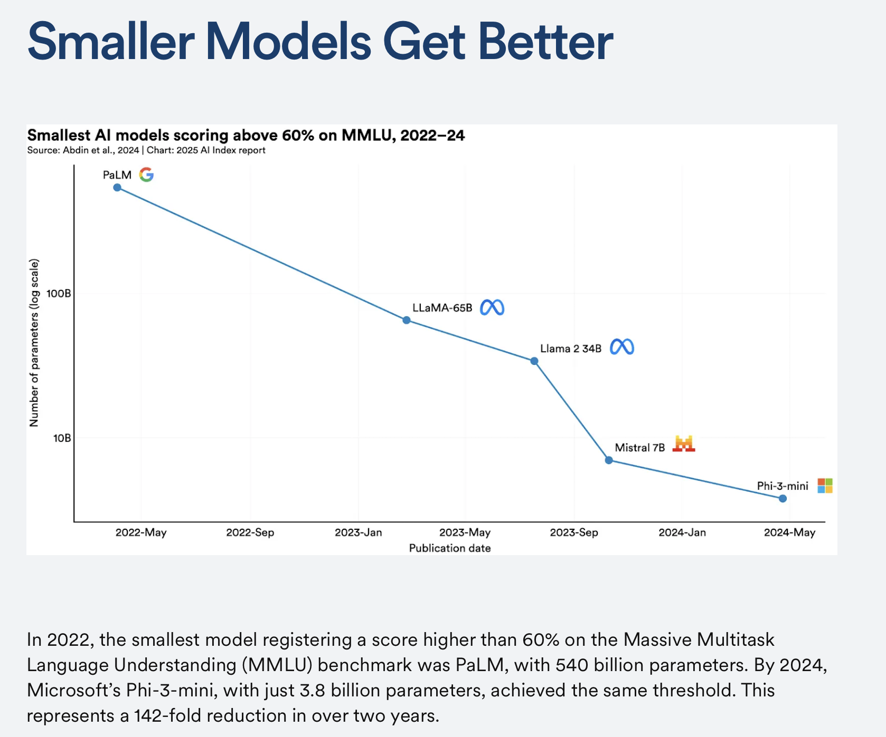
The case for “small” language language models (SLMs)
https://hai.stanford.edu/news/ai-index-2025-state-of-ai-in-10-charts

Slide 21
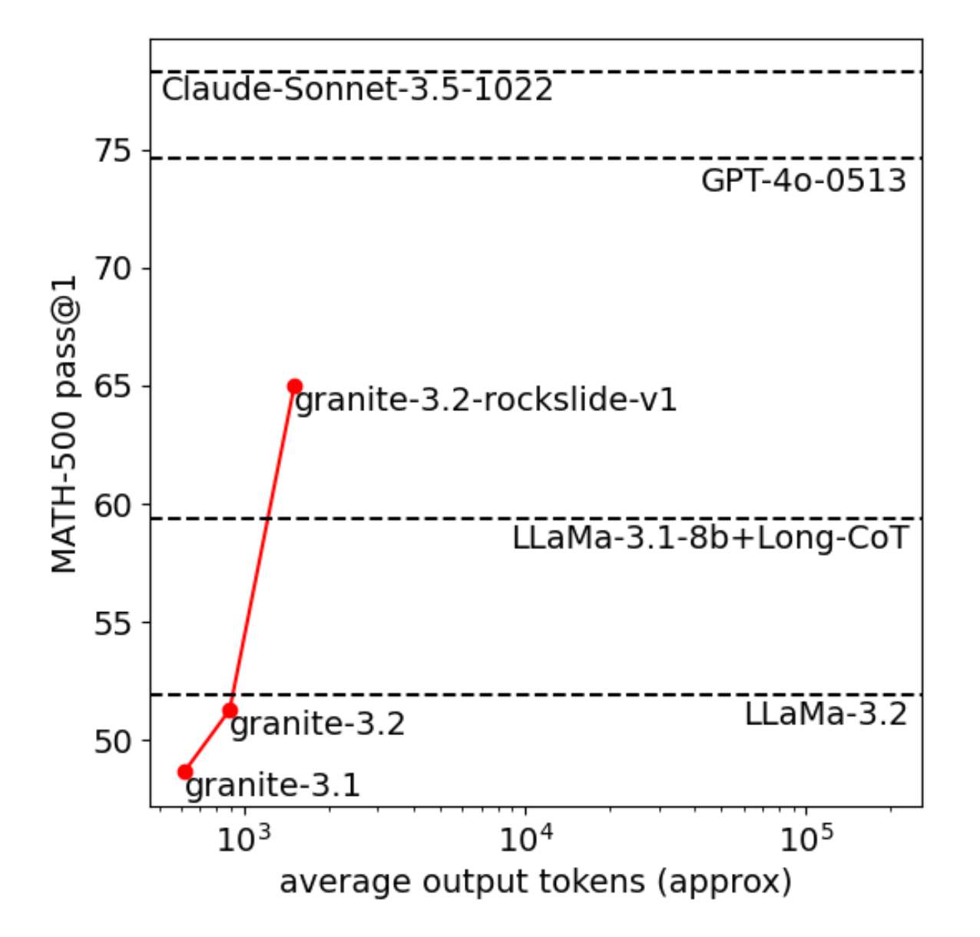
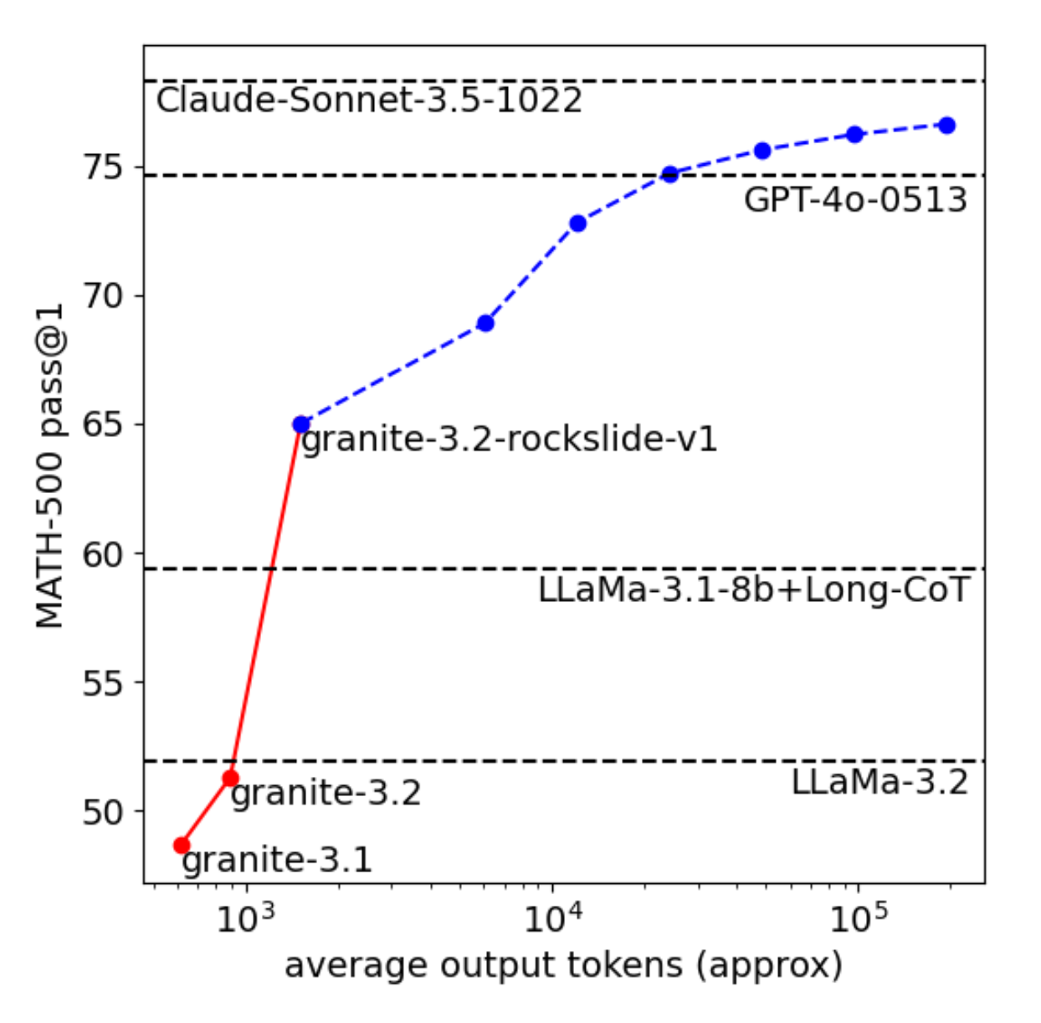
Inference-Time Techniques Enable SLMs to Achieve LLM-Like Performance

Slide 22
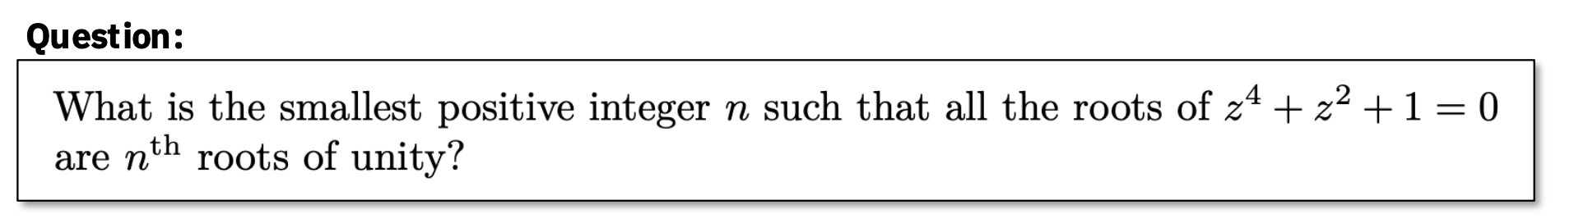
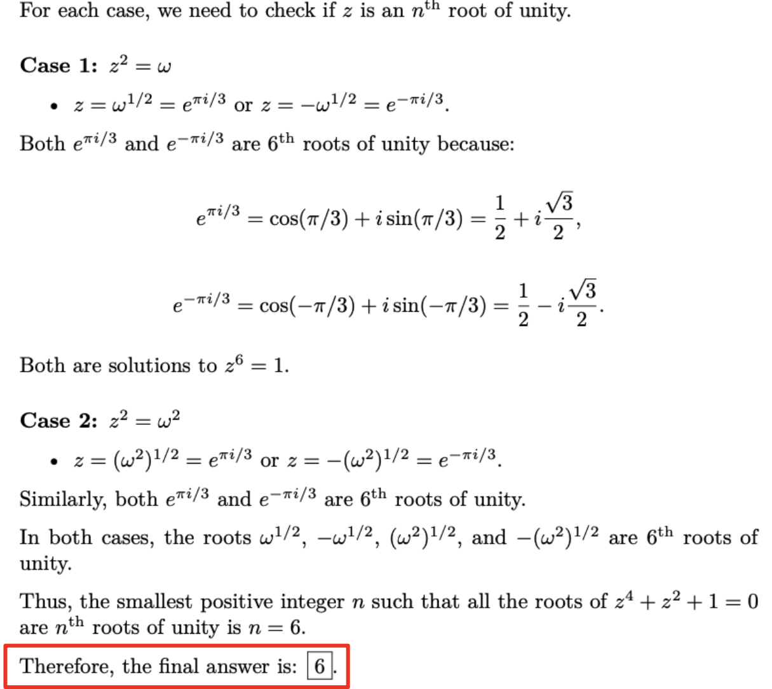
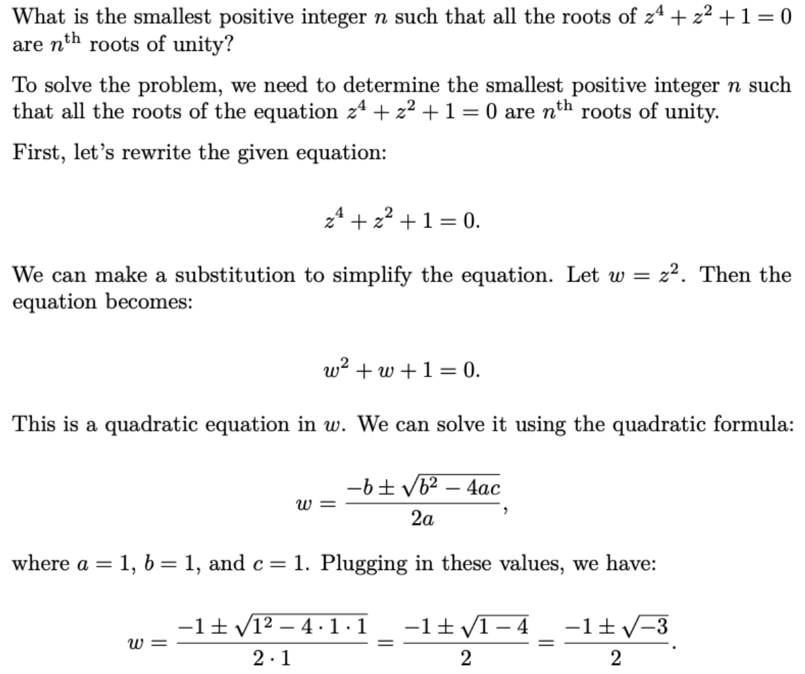
With inference scaling, small models can punch well above their weight

Slide 23
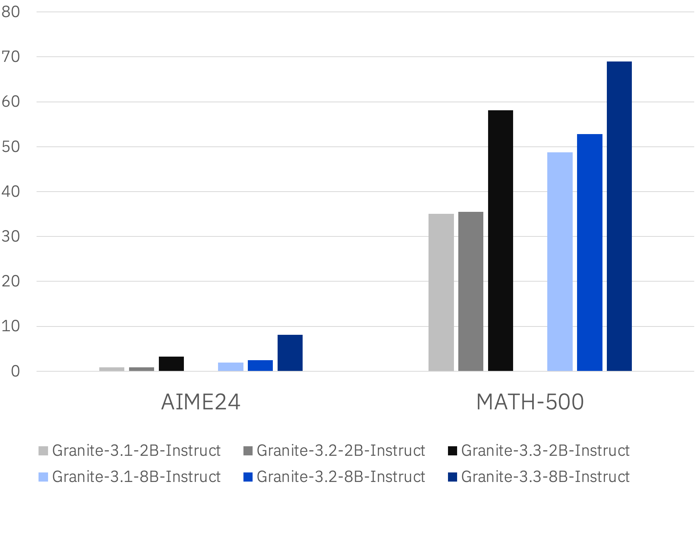
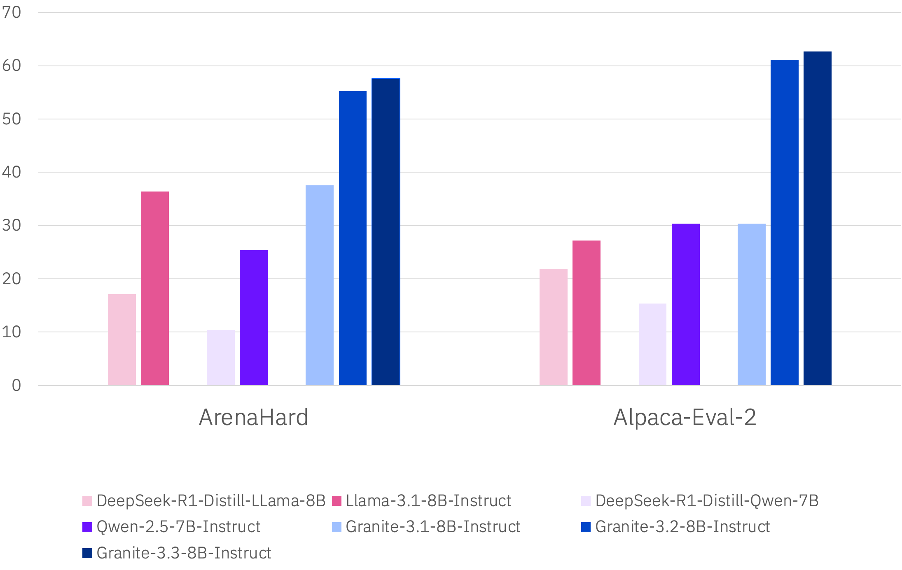
Granite Advances Reasoning with RL Innovations

Slide 24
SLMs are much less expensive to operate
Granite is 1/50th the cost of GPT-4o
1
1
3
4
2
As of April 6th, 2025:
¹https://openai.com/api/pricing/ ²https://www.anthropic.com/news/claude-3-7-sonnet
³https://ai.google.dev/gemini-api/docs/pricing
⁴https://www.ibm.com/products/watsonx-ai/pricing

Slide 25
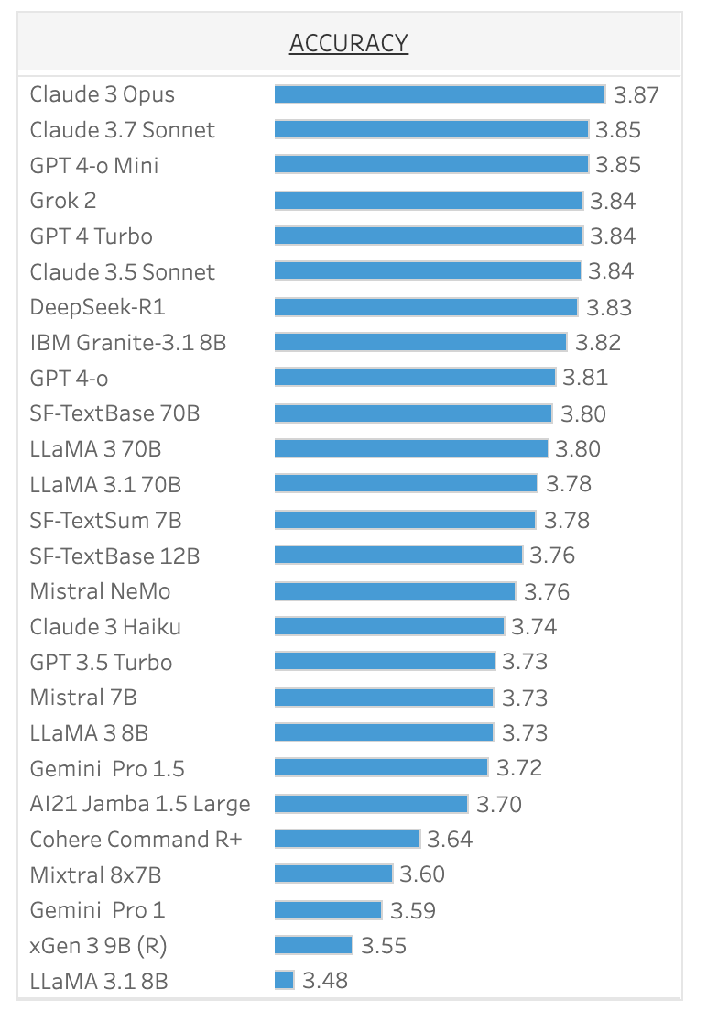
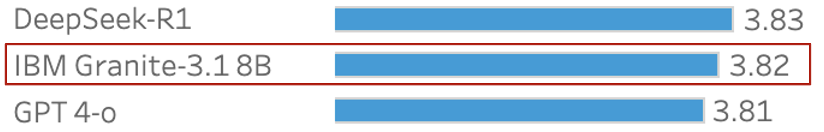
SLMs are powerful tools for maximizing your ROI
Especially for many no-nonsense enterprise tasks
Average summarization accuracy on
Salesforce Customer Relationship Management Leaderboard
5x cost →
22x cost →
Performance Pricing from model providers’ website, assumes 3:1 blended rate

Slide 26
SLMs are powerful tools for maximizing your ROI
Especially when customized on enterprise data
Performance of Granite models specialized with InstructLab
compared to general-purpose alternatives
Q&A over standard operating procedures
for reconciliation process
Analysis of customer call transcripts
90%
93.6% cheaper
85%
80%
Performance
95.7% cheaper*
75%
70%
65%
60%
55%
50%
Granite
7B + ILab
GPT-4
Turbo
Granite
7B + ILab
Large Frontier Model
$0.60/M tokens
$14/M tokens
$420K/year
(no RAG)
$6.6M/year
(no RAG)
Notes:
We have seen several early PoCs that demonstrate when Granite-7B is customized with Instructlab, we are able to deliver the same or better performance as a larger model, while running at up to 98.5% cheaper at inference time.

Slide 27
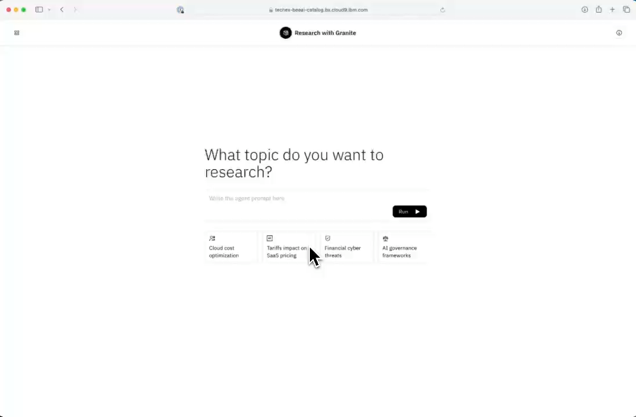
What required a
big model yesterday
can often be done
with a SLM today
IBM Think 2025

Slide 28
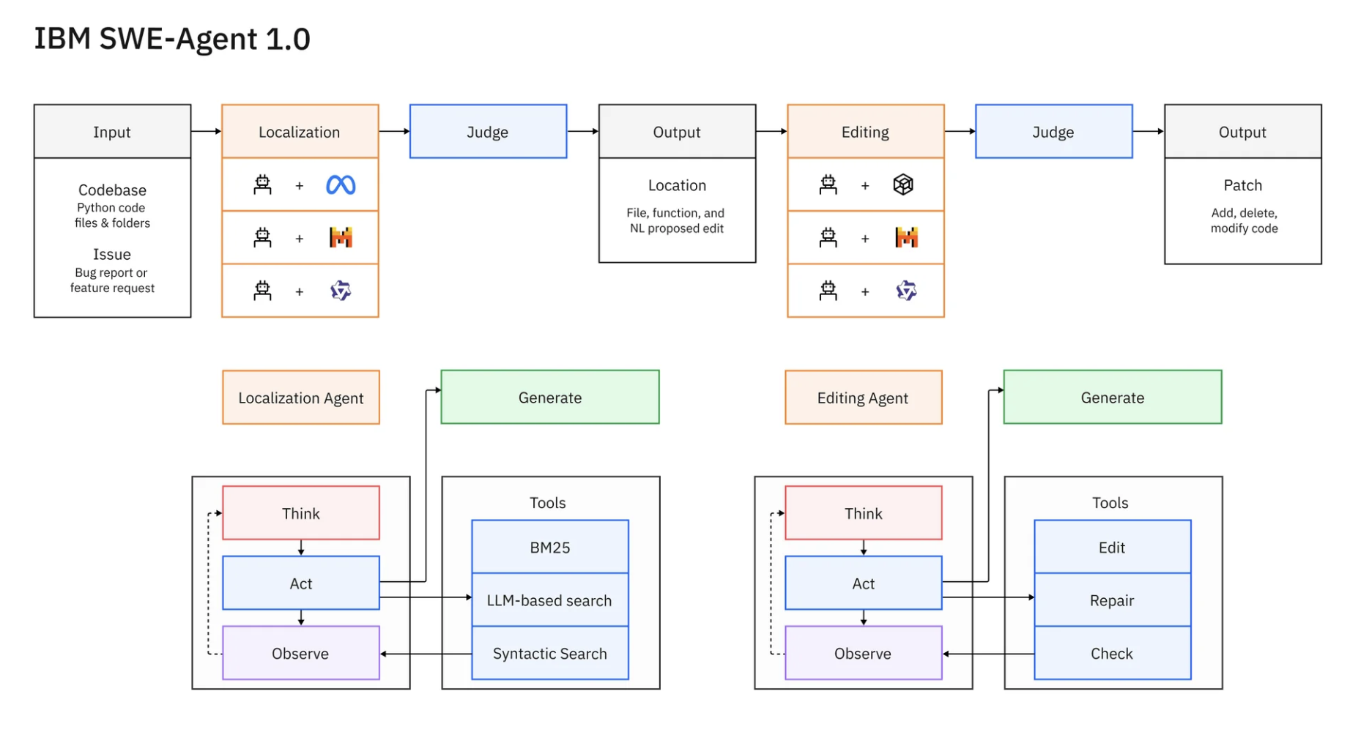
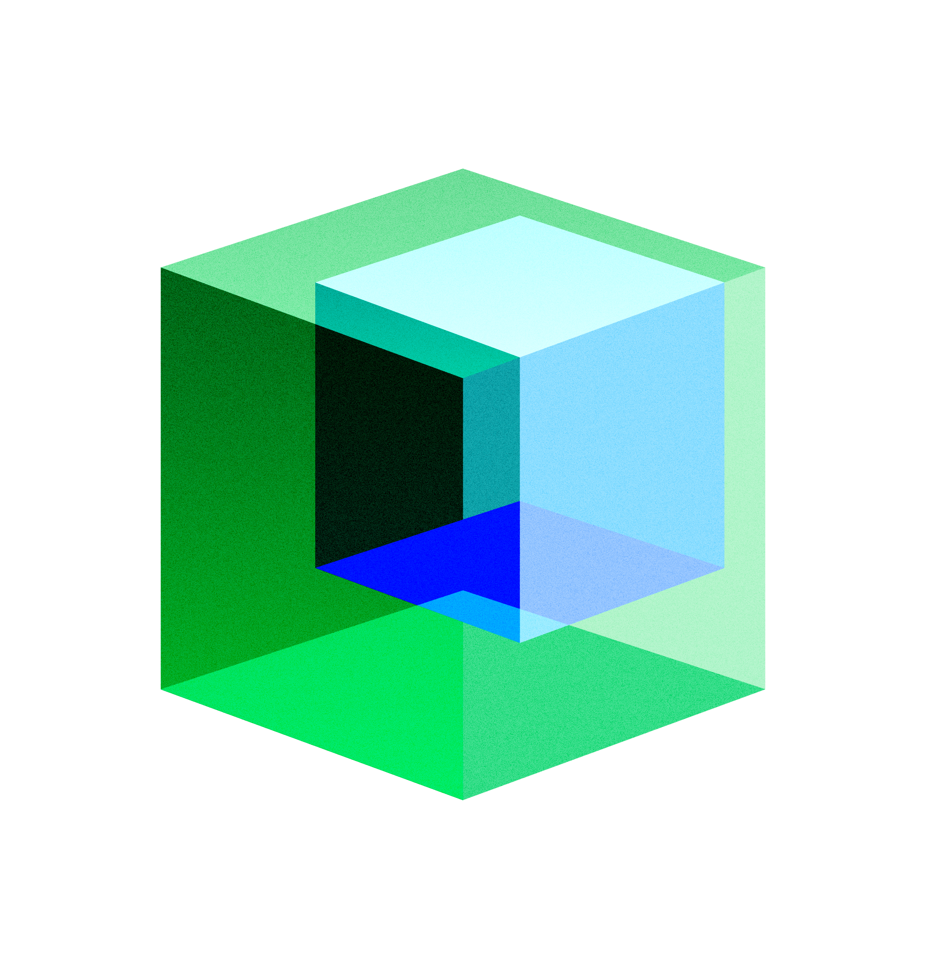
The future of agents will require small and big models working together
https://research.ibm.com/blog/ibm-swe-agents
Notes:
Draw you attention to something – point 1 difference on a factor of three – is that .02% accuracy worth 50x the cost

Slide 29

Reasoning Toggling
What weighs more? A pound of feathers or a kilogram of lead?
Thinking off
Thinking on
A kilogram of lead weighs more than a pound of feathers.
Here’s the conversion: 1 kilogram is approximately 2.20462 pounds. So, a kilogram of lead, which is already a kilogram, would weigh more than a pound (16 ounces or 0.453592 kilograms) of feathers.
Here is my thought process:
This question is a classic example of a unit conversion problem. It's asking to compare a weight in pounds (a unit used in the imperial system) with a weight in kilograms (a unit from the metric system). The goal is to determine which is heavier when converted to the same unit.
Here is my response:
To answer this, we need to convert both weights into the same unit. Let's convert them to pounds since 1 pound is a more familiar unit in the imperial system.
Given:
1 pound of feathers
1 kilogram of lead
Conversion Factors:
1 kilogram = 2.20462 pounds
Conversion:
Pounds of Feathers: 1 pound of feathers is already 1 pound.
Pounds of Lead: 1 kg * 2.20462 pounds/kg = 2.20462 pounds
Comparison:
1 pound of feathers = 1 pound
1 kilogram of lead = 2.20462 pounds
Conclusion:
A kilogram of lead weighs more than a pound of feathers. A kilogram of lead is heavier.
Note: This is a common trick question because intuitively, 'pound' might suggest a larger amount due to its name. However, when converted to the same unit (pounds), it's clear that 1 kg of lead is indeed heavier.

Slide 30
Granite features a new suite of LoRA adaptors to further augment RAG workflows
RAG Adapter Suite
(released 4/17/2025)
Hallucination Detection
Quantized certainty scores to gauge model confidence in its own outputs
Query Rewrite
Auto-rewrites context-dependent queries into standalone, retriever-friendly form.
Seamless LoRA adapter switching without KV cache recomputation - optimized for low-latency, inference-efficient deployment.
Citation Generation
Sentence-level citations with supporting evidence from retrieved sources
Answerability Prediction
Classifies queries as answerable or unanswerable based on retrieved content
Uncertainty Prediction
Calibrated certainty scores to gauge model confidence in its own outputs
https://www.ibm.com/new/announcements/ibm-granite-3-3-speech-recognition-refined-reasoning-rag-loras
Notes:
Seamless adapter switching without cache recomputation

Slide 31
With Citation LoRA
Doc 1
Git Repos and Issue Tracking is an IBM-hosted component of the Continuous Delivery service. All of the data that you provide to Git Repos and Issue Tracking, including but not limited to source files, issues, pull requests, and project configuration properties, is managed securely within Continuous Delivery. However, Git Repos and Issue Tracking supports various mechanisms for exporting, sending, or otherwise sharing data to users and third parties. The ability of Git Repos and Issue Tracking to share information is typical of many social coding platforms. However, such sharing might conflict with regulatory controls that apply to your business. After you create a project in Git Repos and Issue Tracking, but before you entrust any files, issues, records, or other data with the project, review the project settings and change any settings that you deem necessary to protect your data. Settings to review include visibility levels, email notifications, integrations, web hooks, access tokens, deploy tokens, and deploy keys. Project visibility levels \n\nGit Repos and Issue Tracking projects can have one of the following visibility levels: private, internal, or public. * Private projects are visible only to project members. This setting is the default visibility level for new projects, and is the most secure visibility level for your data. * Internal projects are visible to all users that are logged in to IBM Cloud. * Public projects are visible to anyone. To limit project access to only project members, complete the following steps:\n\n\n\n1. From the project sidebar, click Settings > General. 2. On the General Settings page, click Visibility > project features > permissions. 3. Locate the Project visibility setting. 4. Select Private, if it is not already selected. 5. Click Save changes. Project membership \n\nGit Repos and Issue Tracking is a cloud hosted social coding environment that is available to all Continuous Delivery users. If you are a Git Repos and Issue Tracking project Maintainer or Owner, you can invite any user and group members to the project. IBM Cloud places no restrictions on who you can invite to a project.
...
After you create a project in Git Repos and Issue Tracking, but before you entrust any files, issues, records, or other data with the project, review the project settings and change any settings that are necessary to protect your data. Settings to review include visibility levels, email notifications, integrations, web hooks, access tokens, deploy tokens, and deploy keys. Project visibility levels \ \n\nGit Repos and Issue Tracking projects can have one of the following visibility levels: private, internal, or public. * Private projects are visible only to project members. This setting is the default visibility level for new projects, and is the most secure visibility level for your data. * Internal projects are visible to all users that are logged in to IBM Cloud. * Public projects are visible to anyone. To limit project access to only project members, complete the following steps:\n\n\n\n1. From the project sidebar, click Settings > General. 2. On the General Settings page, click Visibility > project features > permissions. 3. Locate the Project visibility setting. 4. Select Private, if it is not already selected. 5. Click Save changes. Project email settings \n\nBy default, Git Repos and Issue Tracking notifies project members by way of email about project activities. These emails typically include customer-owned data that was provided to Git Repos and Issue Tracking by users. For example, if a user posts a comment to an issue, Git Repos and Issue Tracking sends an email to all subscribers. The email includes information such as a copy of the comment, the user who posted it, and when the comment was posted. To turn off all email notifications for your project, complete the following \ steps:\n\n\n\n1. From the project sidebar, click
Doc N
Project visibility levels \ \n\nGit Repos and Issue Tracking projects can have one of the following visibility levels: private, internal, or public. * Private projects are visible only to project members. This setting is the default visibility level for new projects, and is the most secure visibility level for your data. * Internal projects are visible to all users that are logged in to IBM Cloud. * Public projects are visible to anyone. To limit project access to only project members, complete the following steps:\n\n\n\n1. From the project sidebar, click Settings > General. 2. On the General Settings page, click Visibility > project features > permissions. 3. Locate the Project visibility setting. 4. Select Private, if it is not already selected. 5. Click Save changes. Project email settings \n\nBy default, Git Repos and Issue Tracking notifies project members by way of email about project activities. These emails typically include customer-owned data that was provided to Git Repos and Issue Tracking by users. For example, if a user posts a comment to an issue, Git Repos and Issue Tracking sends an email to all subscribers. The email includes information such as a copy of the comment, the user who posted it, and when the comment was posted. To turn off all email notifications for your project, complete the following \ steps:\n\n\n\n1. From the project sidebar, click Settings > General. 2. On the \ **General Settings **page, click Visibility > project features > permissions. \ 3. Select the Disable email notifications checkbox. 4. Click Save changes. Project \ integrations and webhooks
Query: What is the visibility level of Git Repos and Issue Tracking projects?
Retrieved output:
Git Repos and Issue Tracking projects can have one of three visibility levels: private, internal, or public [1]. Private projects are only visible to project members, internal projects are visible to all users logged in to IBM Cloud, and public projects are visible to anyone [2,3,4].
[1] Doc 1, offsets 1034-1178: "Project visibility levels \n\nGit Repos and Issue Tracking projects can have one of the following visibility levels: private, internal, or public."
[2] Doc 1, offsets 1179-1234: "* Private projects are visible only to project members."
[3] Doc 1, offsets 1353-1430: "* Internal projects are visible to all users that are logged in to IBM Cloud."
[4] Doc 1, offsets 1431-1471: "* Public projects are visible to anyone."

Slide 32
Generative computing makes GenAI:
→ Efficient
→ Secure
→ Portable
→ Maintainable

Slide 33
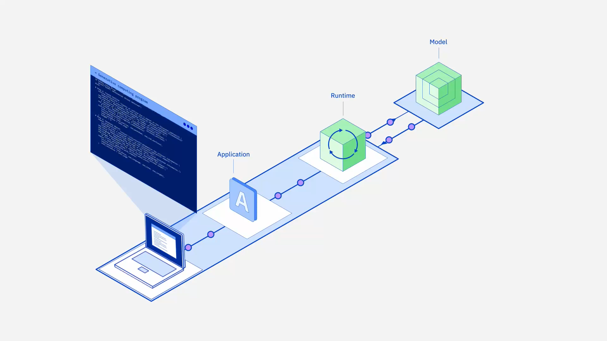

Slide 34
Granite 4.0
→ Coming this summer
90%+
reduction in
cost compared
to larger models
80%+
reduction in
GPU memory
than comparable models
2-5x ​
faster than
comparable
models​
Granite-4.0-Tiny
Local experimentation (laptop), edge and CPU based deployments.
Fits on a single 3060 GPU.
Granite-4.0-Small
Workhorse enterprise model for tasks like RAG, agents, summarization, generation.
Fits on a single L40S GPU.
Granite-4.0-Medium
Designed for more complex agent and planning-based tasks.
Fits on a single node.
Notes:
Granite is A family of open, performant, and trusted AI models to accelerate Enterprise AI adoption.
Open-sourced under Apache 2.0, all Granite models, ranging from sub-billion to 34 billion parameters deliver industry-leading accuracy and cater to diverse developer and business needs.
It includes foundation models for code, language, time series, agents, safety via the Granite Guardian companion model, and even geospatial data
But the biggest differentiator for Granite is the quality of the data that trains them and the transparency we offer to our clients to show how our models are built and trained.
IBM has carefully curated enterprise-grade data for training -- things like code data from GitHub or transcripts from earnings calls and finance textbooks.
And we make those data sets transparent so you can see what went into the model
And they’re highly efficient, reducing the cost of operation by requiring less compute power

Slide 35
Generative computing
is what’s next for enterprise AI.

